Slide 1
HttpClient
Async Result
HTTP DELETE
deleteAsync(uri) postAsync(uri, content) putAsync(uri, content)
sendRequestAsync(message)
getAsync(uri)
getBufferAsync(uri)
getInputStreamAsync(uri)
getStringAsync(uri)
HttpResponseMessage
HttpResponseMessage
HttpResponseMessage
HttpResponseMessage
HttpResponseMessage
IBuffer
IInputStream
string
HTTP PUT
Web/Cloud Resources
HTTP POST
HTTP *
Filters (app supplied)
HTTP GET
HTTP GET
HTTP GET
HTTP GET
HttpResponseMessage.content:
readAsStringAsync
readAsInputStreamAsync
readAsBufferAsync
bufferAllAsync [into memory]
writeToStreamAsync [to output stream]
headers [collection]
tryComputeLength
parse as needed
save to file, convert to blob
save to file, apply encryption

Slide 2

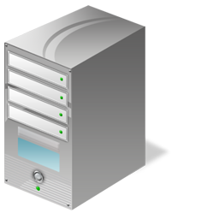



7. Data access
Web Auth Broker
WinRT
6. Authorization token (Redirect URL)
1. Authorization Request (Start URL)
Online
Service
Windows Store App
2. Login page
3. Credentials
Dialog
4. Authorization page
5. User decision
User

Slide 3
①
Web Auth Broker
②
App
Service
Auth request with https provider URI
Service Login Page
Page request
Username
Password
Submit
Login
③
Authenticate
Service Authorization Page(s)
Yes, allow use of my <feature>
No, do not allow <feature>
Submit
OK
Generate Token
④
Token
Response containing a token
APIs
API calls with the token
⑤

Slide 4
①
③
②
⑦
⑥
④
⑤
⑧

